Slide 1
Online Food Ordering system organization: bentayan food court
Programme: RSF2 Group 5
Lee Ling
Joan Hau
Lim Ming Yeu
Tan Yong Kang
Cheong Yin Lam

Slide 2
Organization Background
Location: Jalan Bakri, Taman Sri Emas, 84000 Muar, Johor
Operate since 1980
Operate hours: 6 p.m. – 10 p.m.
Traditional food court – manual ordering system

Slide 3
1. OBSERVATION
Requirement Gathering Technique
2. QUESTIONNAIRE

Slide 4
PROBLEMS OF EXISTING SYSTEM
1. Inconvenience and time consuming during ordering food
2. Inaccurate calculating profit
3. Communication problem between the stall owner and customer
4. Difficulties in keeping track of orders
5. Limited payment method

Slide 5
Software Quality Attributes
FUNCTIONALITY
2. RELIABILITY
3. SECURITY
4. EFFICIENCY
5. MAINTAINABILITY

Slide 6
Incremental Model
Software Process Model

Slide 7
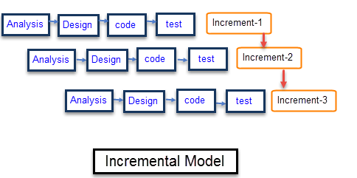
Phases

Slide 8
Increment
Predefined coding standard
Communication
Function and method
checking
product
Increment 1: Register, login and logout Increment 2 : Menu Increment 3: Order Increment 4: Payment Increment 5: Membership Increment 6: Rate, Recommendation and Favorites

Slide 9
Reasons for choosing Incremental Model
1. Faster initial product delivery
2. High client interaction with review and feedback to each iteration
3. Easier to test and debug during a small iteration

Slide 10
Presented by: Lee Ling Tan Yong Kang
Online Food Ordering System

Slide 11
Project Planning Schedule
Software Process Model ： Incremental Model

Slide 12
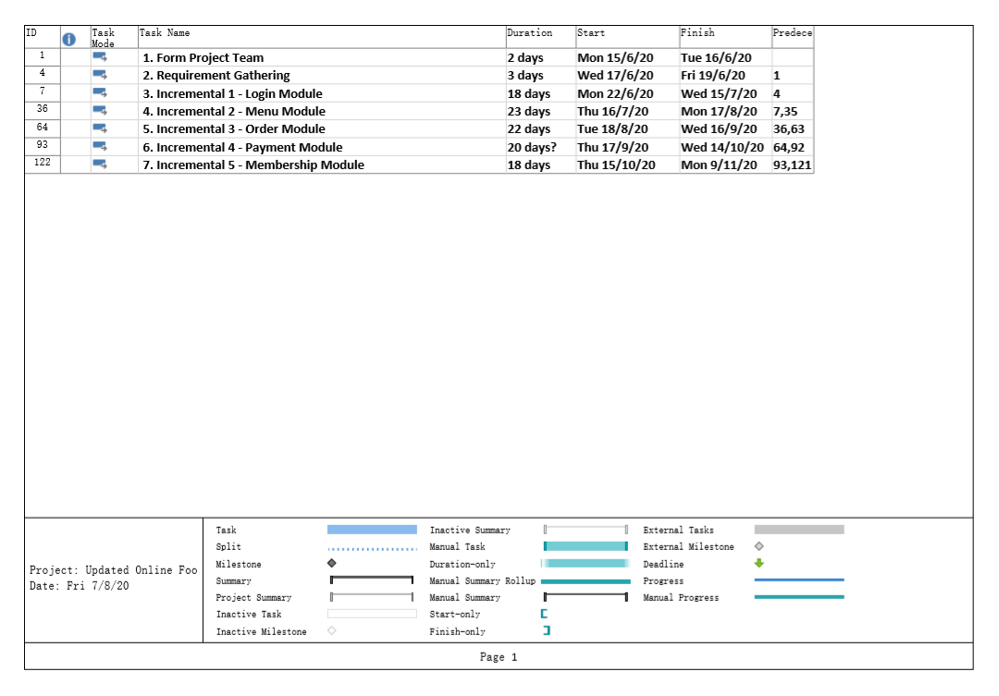

Slide 13
Functional requirements
Online Food Ordering System
Login
Menu
Order
Payment
Membership

Slide 14
Non-functional requirements
Product
Organization
External

Slide 15
All Bentayan Food Court VPs
Interactor Viewpoints
Indirect Viewpoints
Domain Viewpoints
Customers
Food Court Owner
User Interface Standard
Water Bar Staff
Food Court Manager
Waiters
Maintaining Staff
Stall Owner
Stall Staff
Cashier

Slide 16
Online Food Ordering System
Bentayan Food Court
Present By:
Joan Hau
Lee Ling
Cheong Yin Lam
Lim Ming Yeu
Tan Yong Kang

Slide 17
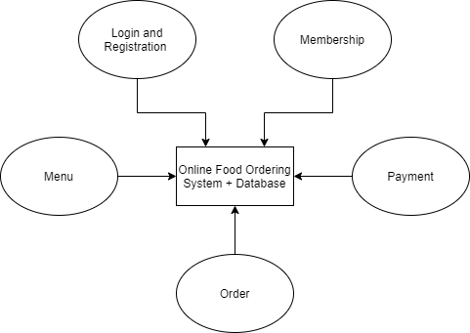
Repository Model

Slide 18
Justification
to store and share large amounts of data to different sub-system
centralized database
no need to concern on how the data is produced

Slide 19
Testing planning and Test Cases

Slide 20
Unit Testing
Login Module
registration form for customer
login form for customer
display welcome page
customer Registration
user login

Slide 21
Unit Testing
Menu Module
display menu
update menu
Order Module
display the order for user
update the order for user and stall owner
add to cart function

Slide 22
Unit Testing
Payment Module
proceed to payment function
multiple payment method for user
display digital receipt for user
Membership Module
display the promotion page
selecting promotion item
display rating page
rate the stall

Slide 23
Module Testing
Login Module
Menu Module
Order Module
Payment Module
Membership Module

Slide 24
Sub-System Testing
System Testing
(incremental 2) Login Module + Menu Module
(incremental 3) Login Module + Menu Module + Order Module
(incremental 4) Login Module + Menu Module + Order Module + Payment Module
(incremental 5) Login Module + Menu Module + Order Module + Payment Module + Membership Module

Slide 25
User Acceptance Testing
(incremental 1) Login Module
(incremental 2) Menu Module
(incremental 3) Order Module
(incremental 4) Payment Module
(incremental 5) Membership Module

Slide 26
Testing Procedures

Slide 27
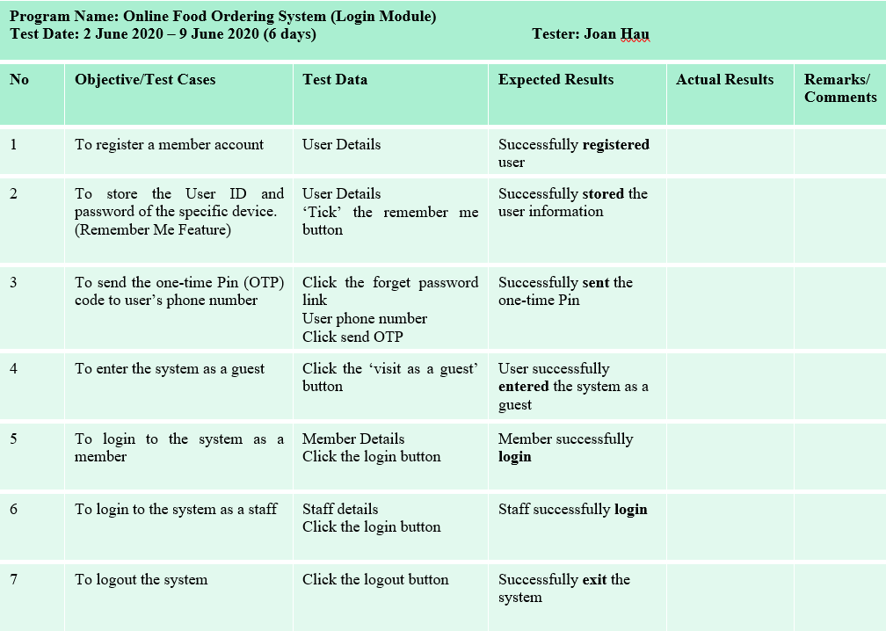

Slide 28
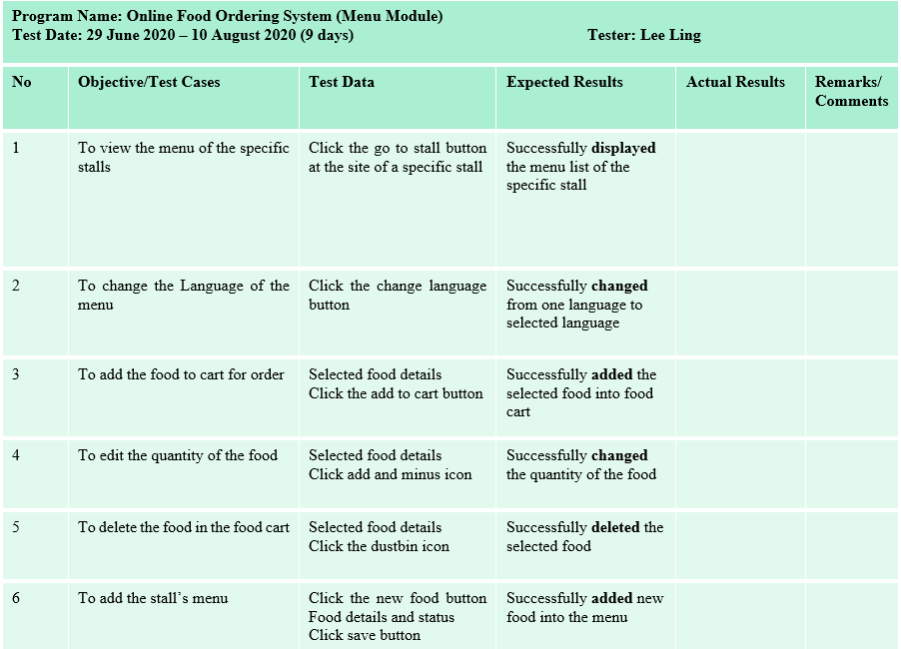

Slide 29
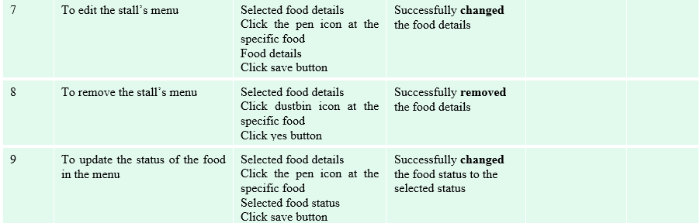

Slide 30
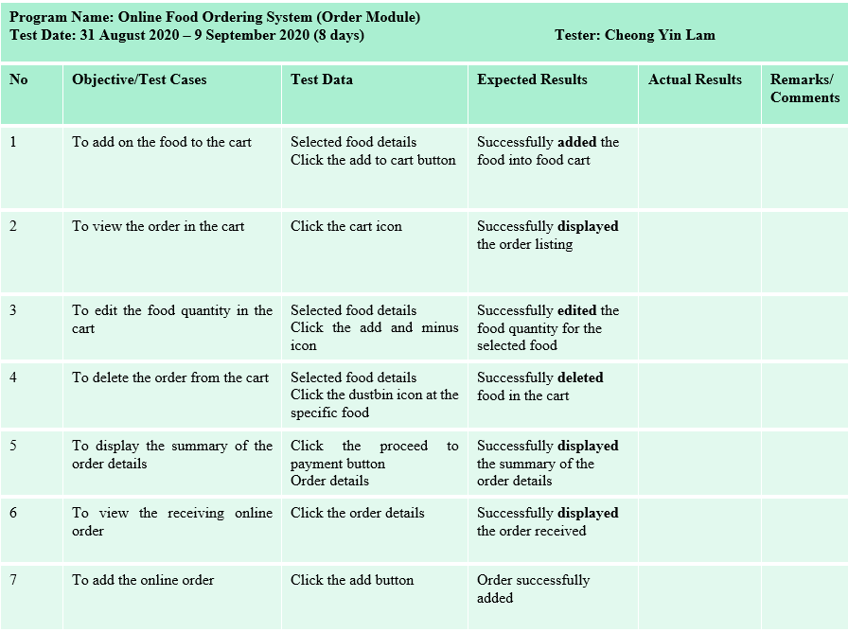

Slide 31
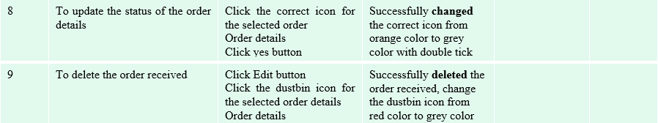

Slide 32
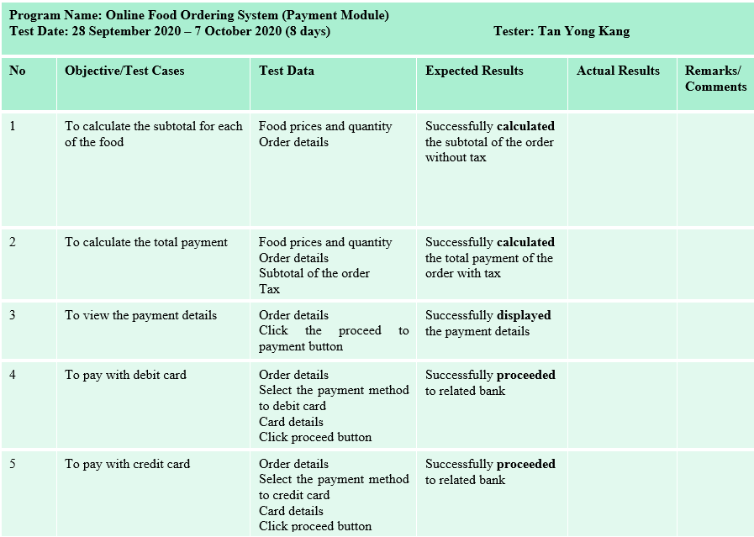

Slide 33
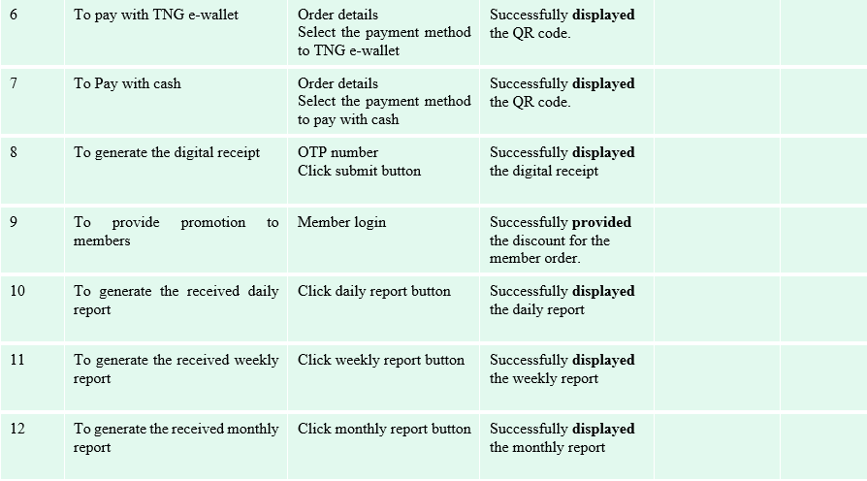

Slide 34
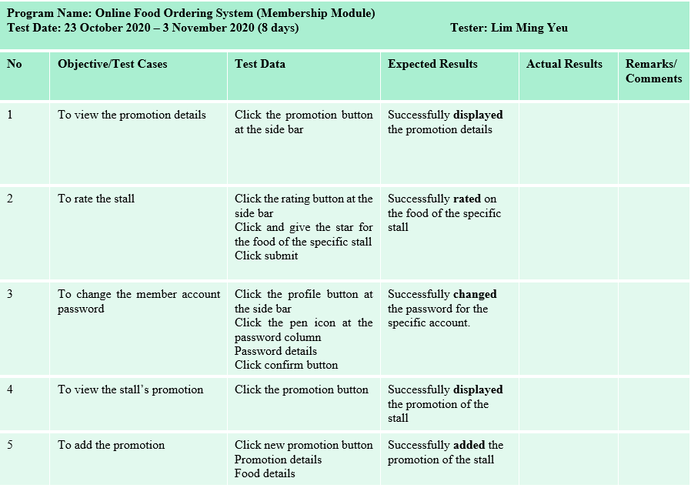

Slide 35
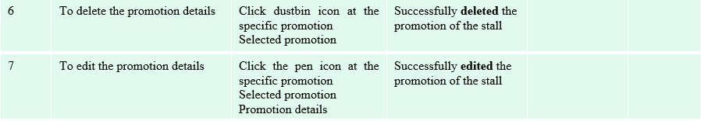

Slide 36
Hardware & Software Requirement
Samsung Note 9
OS Android 8.1
Redmi Note 9
OS Android 10
iPhone 8s Plus
OS iOS 13
Google Chrome
Android Studio

Slide 37
Constraints

Slide 38


Test Item Availability

Slide 39


Test Resources Availability

Slide 40


Time Constraint

Slide 41
User Interface Design Principle
Consistency
Minimal Surprise
User Guidance
Recoverability
User Familiarity
Reduce The User’s Memory Load

